Slide 1
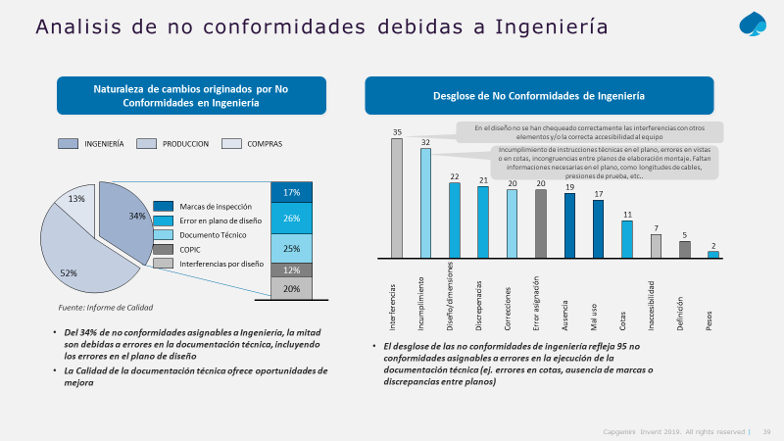
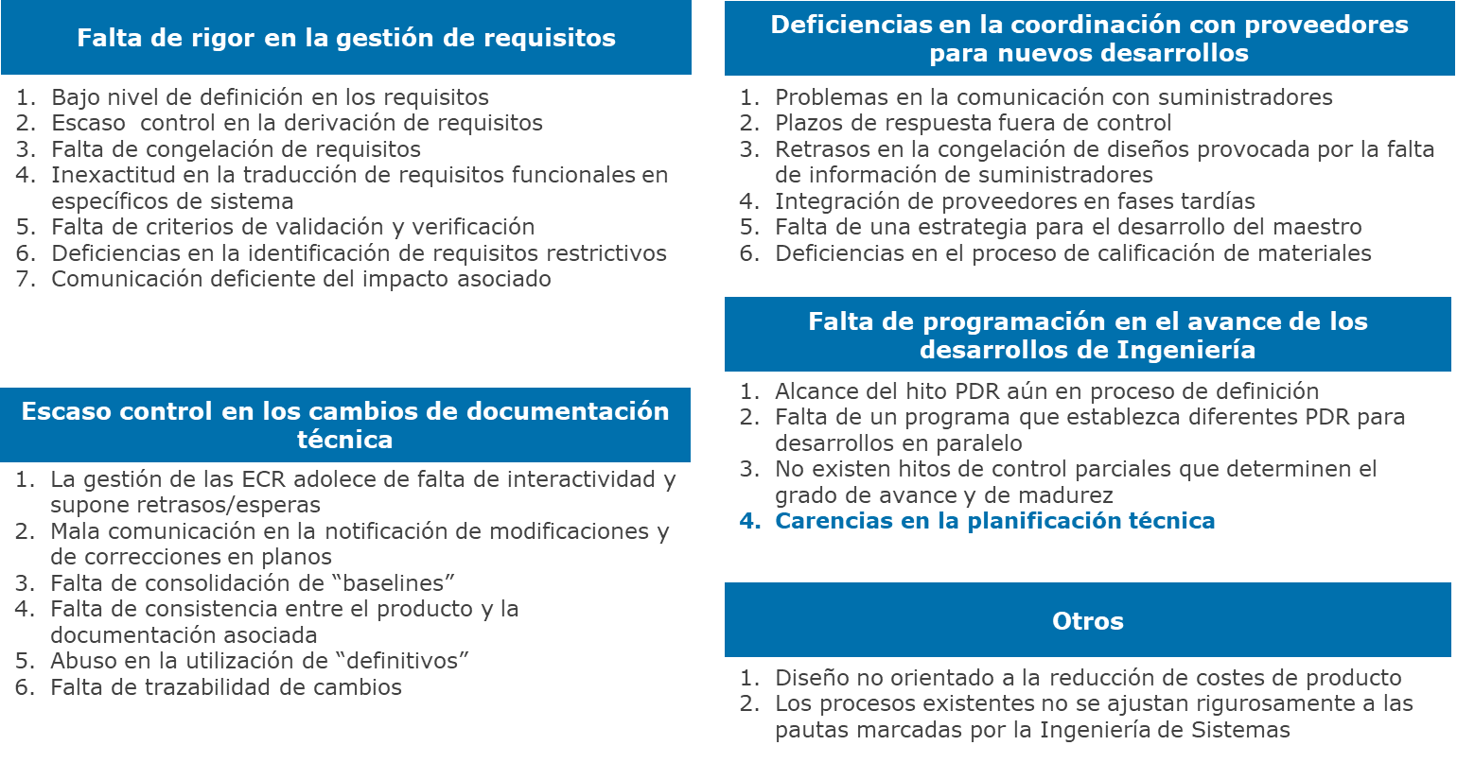
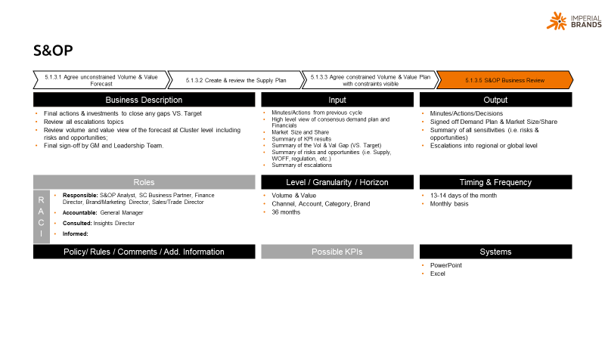
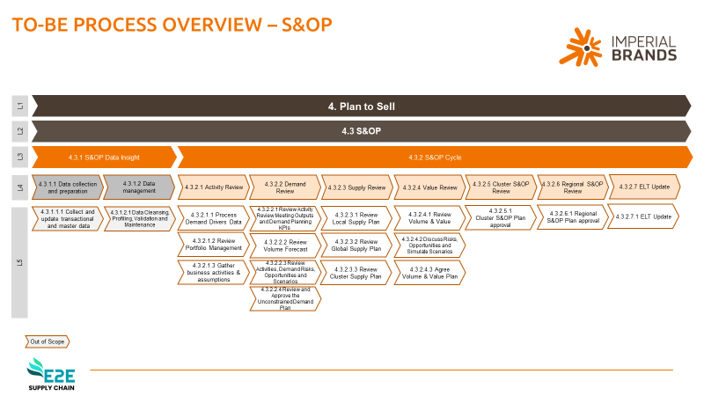
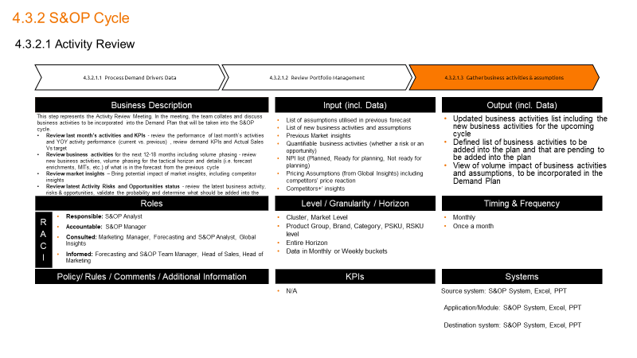
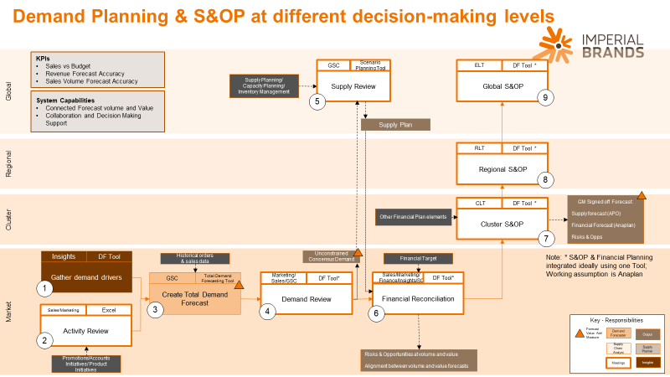
6. DEPLOYMENT AND ROLLOUT
1
MOBILIZATION AND PREPARATION
2
S&OP MATURITY ASSESSMENT
3
ASPIRATIONAL DEFINITION AND TARGET S&OP CYCLE
4
DEMAND AND SUPPLY PROCESSES DESIGN
5
IMPLEMENTATION READINESS AND CHANGE MANAGEMENT
6
DEPLOYMENT AND ROLLOUT
Illustrative
Deployment preparation and mobilization
  Confirm deployment scope, sequence and waves (by category, store cluster, channel…)
  Validate readiness of each wave against defined go-no/go criteria in previous phase
  Confirm go/no go decision prior to execution
  Mobilize deployment teams and confirm stakeholder availability and engagement
  Integrated model deployment (process, org., data…)
  Deploy the target S&OP cycle
  Deploy demand and supply processes
  Implement organizational changes
  Activate planning system configuration
  Hypercare and execution over 2-3 planning cycles
  Monitor and support e2e execution of the model over 2-3 full planning cycles
  Identify execution issues, gaps or misalignments
  Fine-tune processes, roles, data… if needed, based on real execution
  Change management and capability activation
  Execute communication plan aligned with deployment waves
  Deliver role-based training and on-the-job coaching
  KPI tracking and performance stabilization
  Activate KPI and reporting framework
  Monitor adoption and performance KPIs
  Define corrective actions where adoption or performance deviates
  Continuous improvement and handover: consolidate improvements into a stabilized operating model and transition of ownership to business teams
KPIs dashboard
Stabilization and lessons learned report
Validated end-to-end planning cycles execution pack
Embedded operating rhythm & governance confirmation

Slide 2


Demand planning, Supply planning and S&OP implementation
Company confidential

Slide 3

The content of this Proposal is confidential and property of Capgemini. Copyright©2025 Capgemini. All rights reserved.
The information related with concepts, ideas, methodologies and other materials presented in this proposal are only intended to be used by collaborators of the company and solely for the purpose of appraising this proposal and to evaluate Capgemini skills and capabilities related to the future collaboration with the company within the scope of this project.
Total or partial copies of the materials that constitute this proposal cannot be made available to other entities without previous authorization from Capgemini.
References from clients or other entities presented in this proposal cannot be reused without previous authorization from Capgemini.
Capgemini Portugal, S.A.
Capital Social: 6.440.885 € I Matriculada na Conservatória do Registo Comercial de Lisboa sob o número único de matrícula e NIPC 504 272 179
Sede Social: Avenida Colégio Militar 37F, Torre Colombo Oriente, Piso 10, 1500-180 Lisboa, Portugal
Tel.: +351 214 122 200 I Fax.: +351 214 122 299 l E-mail.: geral.pt@capgemini.com

Slide 4
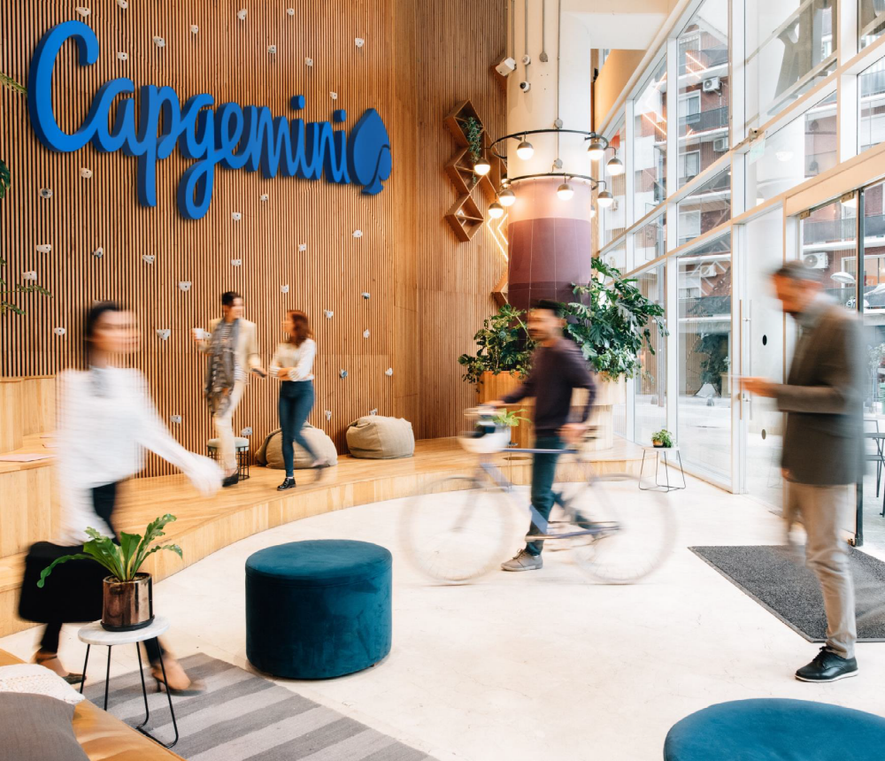
Foreword
  In response to your invitation, Capgemini presents the current proposal to support the deployment of “Demand planning, Supply planning and S&OP implementation for the company“.
  Setting together ambitious yet realistic expectations and actionable recommendations founded on a “doer” perspective will be key for the success of your project. Based on this conviction, and to mark our will to commit, we propose to invest at your side and provide you, at a competitive cost, a team with the key skills to leverage the success of this project.
  Also, as Capgemini Group, we are very keen to strengthening our long standing professional relationship with the company. We remain fully committed to supporting the company in this new phase of its improvement journey.
  You can count on our personal commitment to fully mobilize the best of entire Capgemini Group capabilities to make your project a success.
Operations Director
Sales Director

Slide 5
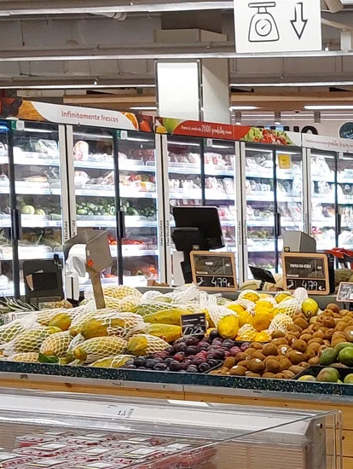
Agenda
Context, Objectives and Scope
Why Capgemini
Our vision and methodology
Project plan
Proposed team and governance model
Economics
Credentials
CVs

Slide 6
the company is integrating the operations from DIA acquisition, and currently adopting a legacy application solution that supports Demand and Supply Planning for ARP II Stores
Context
Objectives
c
The company is preparing to roll-out a new replenishment planning solution – Relex - to II stores, and therefore faces the following challenges:
The company aims to partner with a consulting firm with proven expertise in large-scale planning transformation programs, ensuring robust process design, implementation, organizational alignment and sustainable adoption for the company’s II. Additionally, ensure design and definitions in a scalable manner for further organisational adoption and expansion.
Strategy: there is a need to continue the execution of ARP II integration with speed and effectiveness
Operations: need to establish processes, procedures and work instructions, for store Demand and Supply Planning, including all cross touchpoint with other business areas (e.g.: Commercial, Performance, …)
Organization and People: define the structure, roles, skills, and roadmap to achieve the desired state of maturity
End-to-end process design: S&OP cycle, Demand planning and Supply Planning from Distribution Centers for the company’s II Stores (acquired from DIA Group)
Define organizational structure to support process design
Define governance model
Definition of KPIs, reporting and performance management
Define change management actions required to implement the new target operating model
At Capgemini, we believe our proven track record in comparable engagements positions us as a reliable partner to
support you through this journey

Slide 7
Agenda
Context and objectives
Why Capgemini
Our vision and methodology
Project plan
Proposed team and governance model
Economics
Credentials
CVs

Slide 8
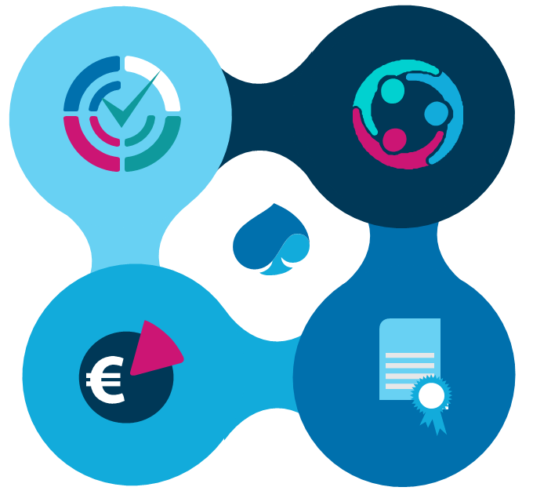
AT CAGEMINI, WE ARE CONFIDENT THAT WE HAVE THE CAPABILITIES REQUIRED TO SUCCESSFULLY GUIDE YOU THROUGH THE REDEFINITION OF THE OPERATING MODEL
Our key capabilities:
WE ARE PARTNERS WITH RELEX
Greater assurance of success by combining strategic expertise with the technological needed to scale initiatives
SUPPLY CHAIN LEADERS
We have developed strong expertise in different areas of the supply chain, including planning and designing efficient operating models
Capgemini aims to continue it’s strong partnership, leveraging it’s insight gained from previous years of experience with The company, namely
Understanding of the company’s Supply Chain strategy
Organizational challenges,
Operational processes, and
Supporting technologies.
OWN ASSETS AND METHODOLOGIES TO ACCELERATE THE PROJECT EXECUTION
We have an extensive library of resources and methodologies for our projects ready to implement
SIMILAR EXPERIENCES IN DEFINING AND IMPLEMENTING NEW OPERATING MODELS
With solid experience, we support clients from different sectors in the design and implementation of new operating models and major transformations

Slide 9

CAPGEMINI BRINGS A UNIQUE SET OF GLOBAL CAPABILITIES AND HANDS-ON EXPERIENCE ACRSOSS INDUSTRIES TO TRANSFORM YOUR SUPPLY CHAIN
Supply chain leaders
BUSINESS
CONSULTING
+550 supply chain consultants
Europe and Africa: 4,800 people
DIGITAL
AND CLOUD
+5,000 Cloud certified experts
Russia
Norway
Sweden
Canada
Netherlands
Poland
America: 1,200 people
UK
SYSTEM
INTEGRATION
+6,600 supply chain system integration experts
US
Luxembourg
France
APAC, India and Oceania: 6,000 people
Morocco
Germany
Spain
China
Mexico
Portugal
Italy
AA/AI
+100 data scientists, experts on supply chain analytics
India
The
Philippines
Guatemala
Singapore
CYBERSECURITY
+4,000 cybersecurity experts
Brazil
BUSINESS
SERVICES
+4,800 supply chain as a service experts
Australia
Business Consulting Capabilities
5G AND EDGE
+10,000 TelCo experts dedicated to 5G & EDGE
AI Center of Excellence with Supply Chain Expertise
Cybersecurity Center
Digital Supply Chain Delivery and Execution Center
Supply Chain Experts
5G & Advanced Network Labs

Slide 10

OUR SERVICE OFFERINGS ADDRESS THE CHALLENGES TO HELP OUR CLIENTS DESIGN, IMPROVE AND OPERATE THEIR END-TO-END SUPPLY CHAIN
Supply chain leaders
SUPPLY CHAIN CONTROL TOWER AND PERFORMANCE MANAGEMENT
7
Design, integrate and deploy cloud–based supply chain platforms, to progressively provide end-to-end visibility, traceability and advanced event monitoring capabilities while driving end-to-end performance
Network monitoring
Planning
Procurement
Manufacture & Distribute
Execution
INTELLIGENT NETWORK DESIGN AND RISK MANAGEMENT
SMART FORECASTING AND INTEGRATED BUSINESS PLANNING
360° SOURCING
ANALYSIS AND SUPPLIER COLLABORATION
SMART MANUFACTURING AND DISTRIBUTION CENTERS
TOUCHLESS AND
AGILE ORDER
TO DELIVERY
1
2
3
4
5
Segment end-markets, differentiate service offerings and design intelligent supply chain networks all along product life cycle, while monitoring systemic risks over time
Design, build and deploy smart forecasting and integrated business planning to better anticipate customer demand while optimizing service, stock levels and enterprise performance management
Design, build and deploy supplier scorecards - resilience, performance and sustainability - and collaborative platforms to constantly improve overall supplier effectiveness
Design, build and deploy smart factory & warehouse solutions to increase throughput, improve productivity and reduce direct & overhead operations costs
Architect, integrate and deploy IS solutions and automation, from smart order management to agile logistics and last mile delivery models, to optimize customer experience and operations
SUPPLY CHAIN
AS A SERVICE
Network monitoring
Planning
Procurement
Manufacture & Distribute
Execution
6
SUPPLY CHAIN AS A SERVICE
Provide externalized business services all along the supply chain while progressively applying best practices and digitalization

Slide 11






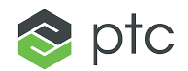


OUR SERVICE OFFERINGS ADDRESS THE CHALLENGES TO HELP OUR CLIENTS DESIGN, IMPROVE AND OPERATE THEIR END-TO-END SUPPLY CHAIN
Supply chain leaders
MATURITY ASSESSMENT
OPERATING MODELS
AUTONOMOUS
PLANNING
INVENTORY AND WASTE MANAGEMENT
Provides the starting point for identifying areas of improvement and achieving the company's objectives
Achieving an efficient model through process and organizational improvements, leveraging technology, including S&OP or IBP
Increase the agility and efficiency of the process by leveraging advanced analytics, enabling a focus on value-added tasks
Ensure visibility and reliability in calculating optimal stock levels
Expected results
Credentials
Partners
Improve OTIF by 5-8%
Decrease of inventory and waste by 10-15%
Improvement of precision and prevision by 7-10%
Decrease of time dedicated to planning by 30%
Increase process efficiency by 45%
Increase of visibility and granularity

Slide 12
We have extensive experience in supply chain planning projects with leading clients from consumer goods and retail
Centralized demand forecasting solution for warehouses, stores and drives.
S&OP Assessment has been conducted to identify gaps and internal best practices, define the S&OP maturity level and share initiatives and roadmap to improve the maturity level.
Planning as a Service. Implementation of Business Services standard tools and harmonized Global Model in all regions.
Understand current pain points that were not allowing the teams to effectively execute the Planning Processes. Best practices are identified as well.
S&OP Process Implementation to strengthen governance and align demand and supply. Introduced a monthly cycle with templates and KPIs for better planning control
S&OP design and implementation for three Houses under the CHORUS program, delivering Anaplan specifications, validated design, and scenario-based decision-making.

Slide 13
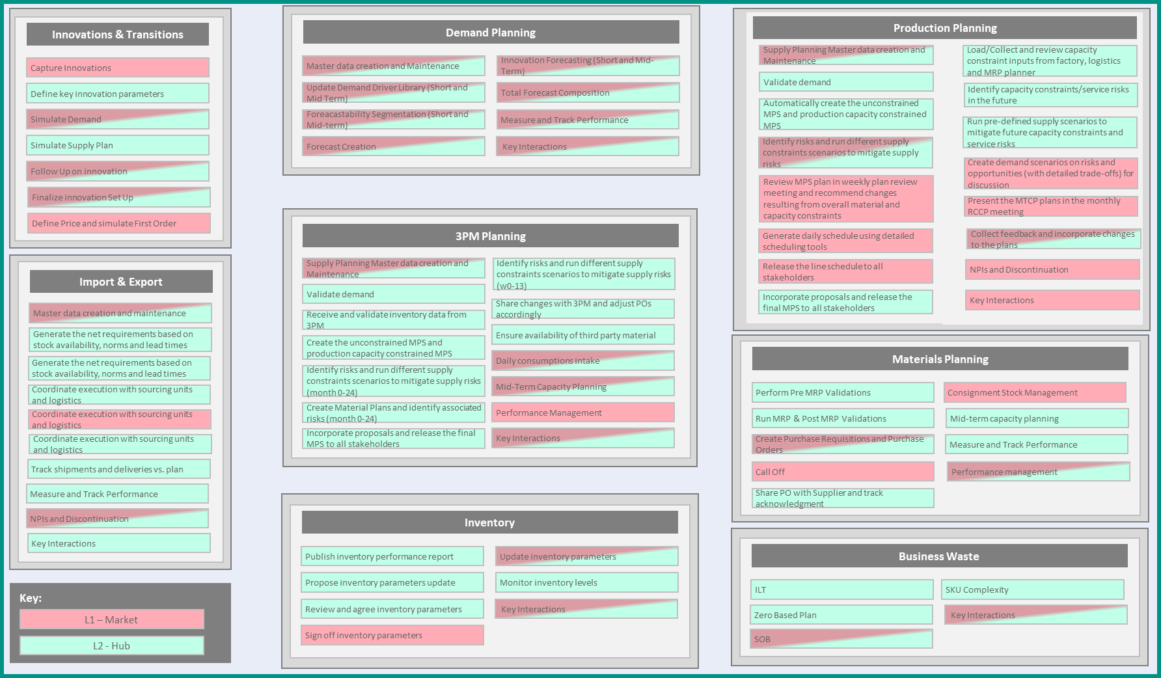
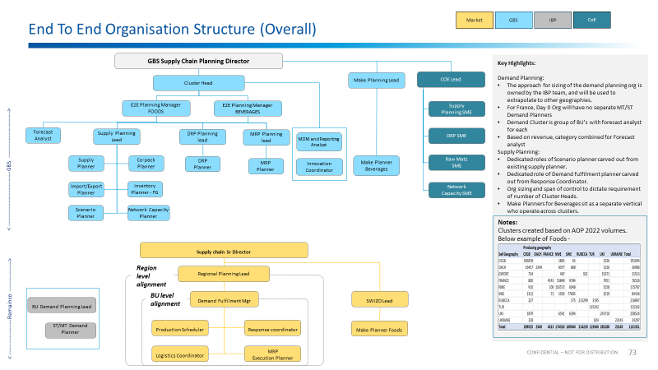
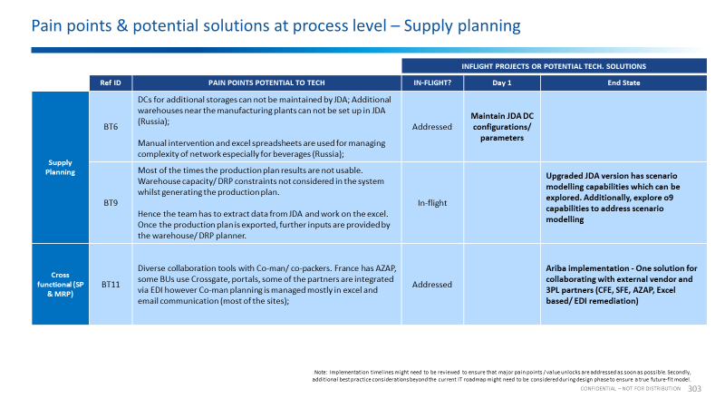
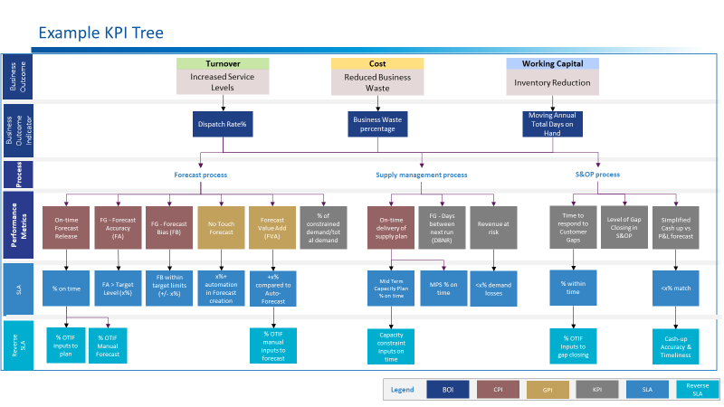
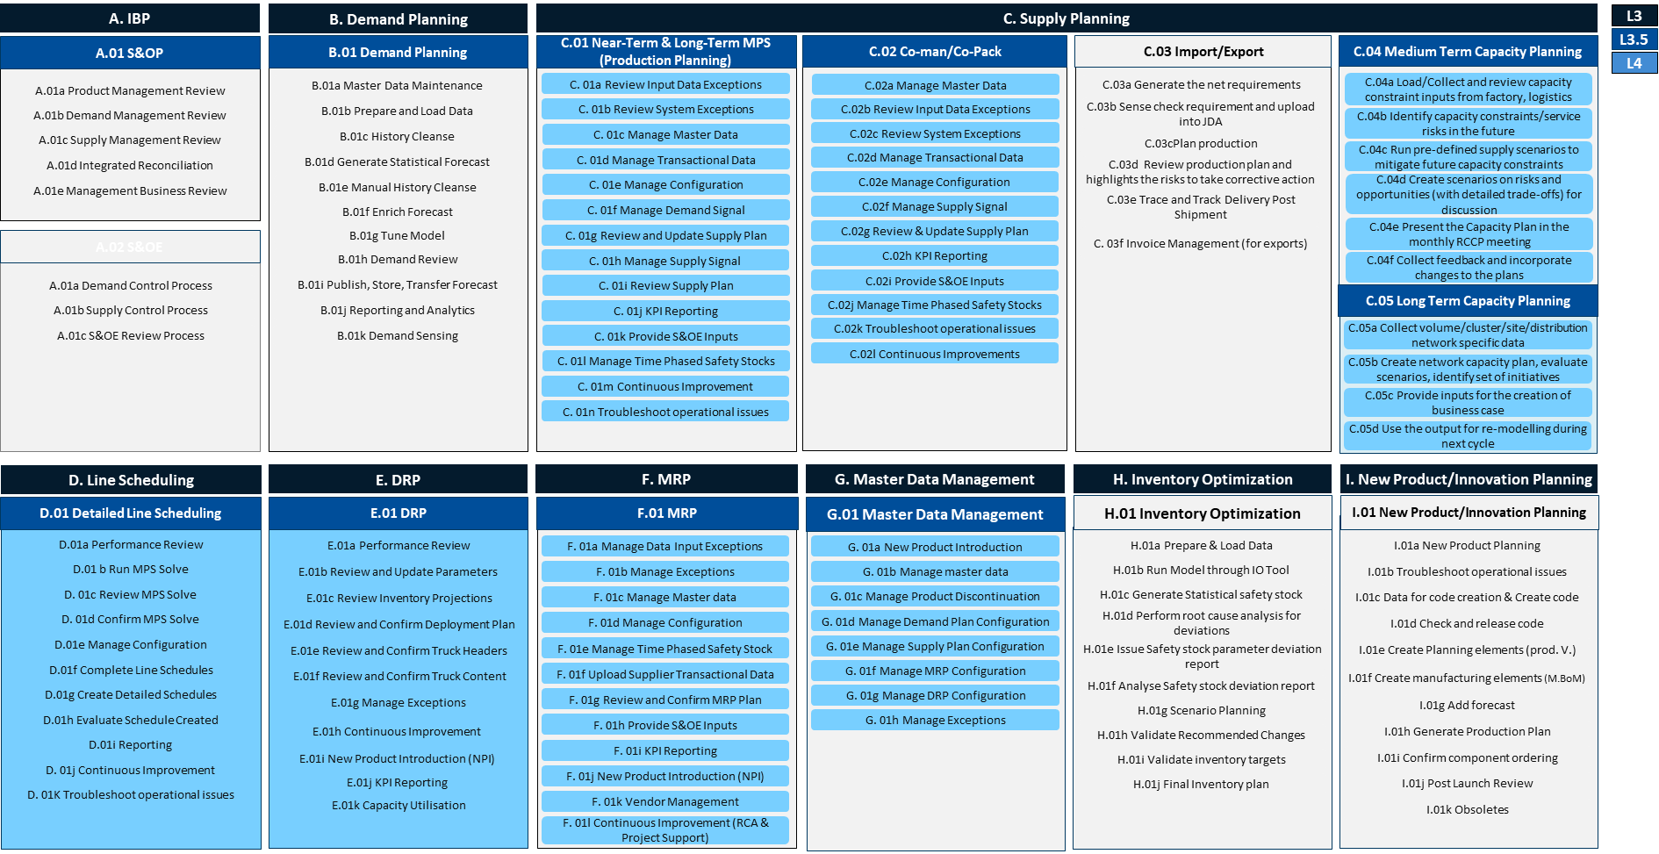
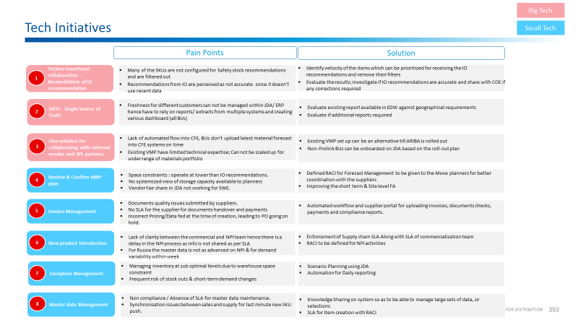
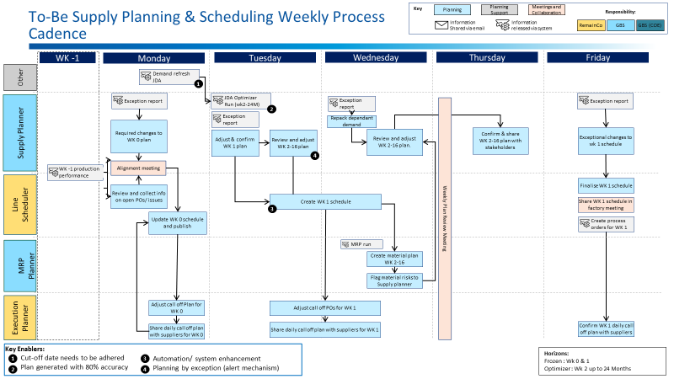
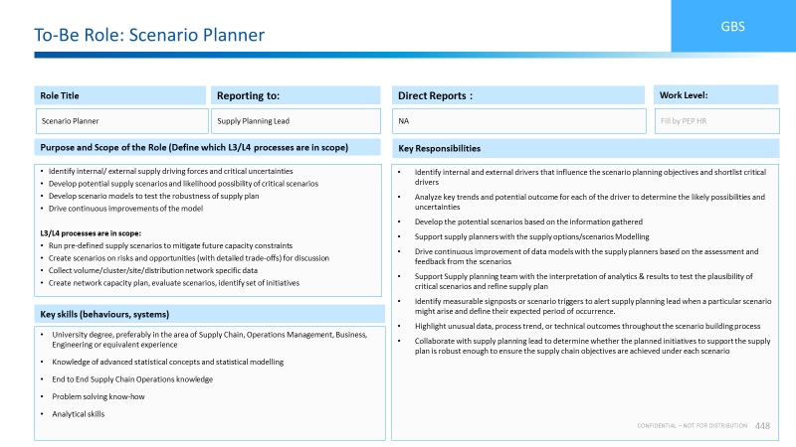
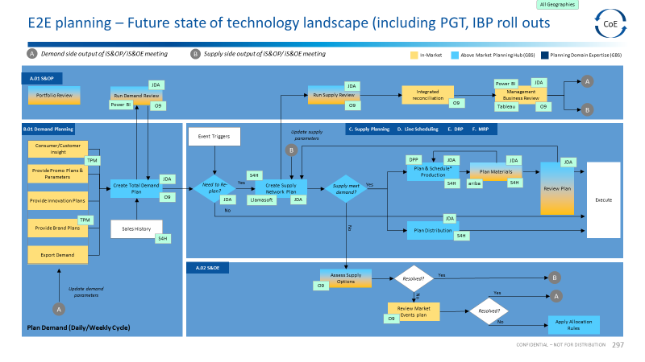
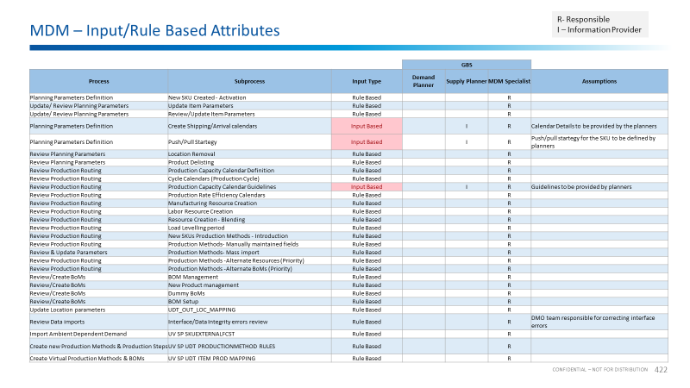
We have relevant assets and knowledge of the planning process that allows us to identify opportunities for improvement
Assets & methodologies
PROCESSES
ORGANIZATION &
GOVERNANCE
TECHNOLOGY
DATA & METRICS
Taxonomy of key processes to be analyzed
Process flows based on best practices
E2E Organizational Model with different scenarios depending on maturity and complexity
Role description
Interaction structure and governance model
List of pre-identified pain points associated with data and technology
Reference solution maps and integrations
Information flows
Hierarchy and list of KPIs and metrics to be evaluated in each of the processes
Identification of the master data required in each process, as well as the optimal feeding and maintenance modality

Slide 14


Through multiple joint projects, we have established a strategic collaboration model with RELEX that is deeply focused on addressing customer challenges
Partnership
Cooperation with RELEX
Through our joint commitment, we can achieve the greatest project success
Solution combined with Mgmt. Consulting
Solution design paired with management consulting for a holistic implementation approach as well as Supply Chain, Retail & RELEX expertise
Best-Practice
Best practices from peer group and use of best practice SAMPOs and processes from RELEX platform
Deployment Capabilities
Experience in numerous deployments at large and medium-sized companies
Capgemini x RELEX
Experience in working with RELEX between Capgemini and RELEX through various projects and an established collaboration model has been developed

Slide 15
Agenda
Context and objectives
Why Capgemini
Our vision and methodology
Project plan
Proposed team and governance model
Economics
Credentials
CVs

Slide 16
Our vision: S&OP as the backbone of demand and supply planning
S&OP CYCLE: decision-making and alignment
PRODUCT
REVIEW
DEMAND
REVIEW
SUPPLY
REVIEW
RECONCILIATION
EXECUTIVE
MEETING
Inputs
Decisions, priorities, approved scenarios
Inputs
ENABLERS:
Demand Planning
Supply Planning
The maturity of the S&OP cycle determines the role and sophistication required from Demand and Supply Planning

Slide 17





Our vision: S&OP MATURITY LEVELS – PLANNING PROCESSES EVOLVE INTO INTERDEPARTAMENTAL, AUTOMATIC AND CIRCULAR EXERCISE
Understanding the current maturity and the aspirational ambition is essential to defining a future operating model
and S&OP cycle that are fit for purpose:
Circular BUSINESS PLANNING
aspiration
Integrated Business Planning
High
Level 5: Continuous Integration
Sales & Operations Planning
PROFITABLE S&OP
Level 4: Scenarios Management
Orchestrating Planning and Execution
Execution and Planning E2E SC integration
Real-Time Visibility and Projections
Deviations management: online What if scenarios and S&OP
Level 3: Financial Impact
Ad-Hoc Planning
Orchestrating:
Profitability decisions in all cycles
Conscious trade-offs
Advanced demand analytics
What if predictive scenarios
Level 2: Planning
Collaborating:
Operational, tactical & strategic cycles
Supply Chain process with stakeholders' collaboration
Finance impact on strategic decisions
Level 1: Operational
Anticipating:
Tactical Plan
Demand and Supply Matching
Supply Chain driven process
Planning
Tool
Reacting:
Operational Plan (MRP)
No process structure
Execution tools
Low
Low
Degree of Supply Chain Capability and Maturity
High

Slide 18
Our approach is based on the analysis of 4 KEY dimensions: only by assessing all dimensions together can a realistic value-added s&op and process model to be defined
Processes
Assess and define Processes of Project and Operations Planning (monthly, weekly and daily cycles, Sales Planning / S&OP, Incident Management)
Governance & Standards (Management of interdependencies and alignment of requirements)
Approval Framework & Escalation process
Interfaces between different teams and areas
Information flows
We help to define and align the processes for smooth functioning following a global approach for all markets
Technology
Infrastructure (Technical and Business requirements)
Digital Ecosystem (Technology, Communication channels – KPI/Dashboard tool, Database, Compliance and Security)
Standardization and visibility through the E2R planning process
We assess the current technology landscape and propose a technology model adapted to the level of maturity and streamline future processes
Organization
Organizational Structure
Roles & Responsibilities (Responsibility split, accountabilities, RACI)
Interactions, dependencies and coordination between stakeholders
Centralization vs Decentralization analysis
We help build strong business case through redefining new roles and an organizational impact assessment
Data & Metrics
Steering & Planning Reporting (KPIs, Performance metrics, Cost, Error Evaluation)
Data Governance and maintenance process
We provide a robust data model that ensures consistency and accessibility of information

Slide 19
Our methodology: from assessment to adoption
Duration: 16 weeks
Duration tbd
1
MOBILIZATION AND PREPARATION
2
MATURITY ASSESSMENT AND ASPIRATIONAL DEFINITION
3
TARGET S&OP CYCLE DEFINITION
4
DEMAND AND SUPPLY ORGANIZATION AND PROCESSES DESIGN
5
IMPLEMENTATION READINESS, CHANGE MANAGEMENT & KPIs
6
DEPLOYMENT AND ROLLOUT
Objectives
Establish a clear foundation for the engagement and ensure alignment from day one
Understand the current S&OP, demand planning and supply planning maturity across key dimensions and define aspirational principles
Design the target S&OP cycle as the decision-making backbone of ARP, taking RELEX process workflow best practices as a starting point
Design Demand and Supply processes and supporting organizational structure aligned with target S&OP taking RELEX process workflow best practices as a starting point
Translate the new target operating model into actionable initiatives, prepare the organization for change and stablish KPI management
Execute the roll out of the new target operating model across the organization, ensuring adoption and operational effectiveness
Aligned scope
Definition of governance model of the project
Aligned ways of working
Clarify stakeholder ownership and engagement model
Fact-based current state maturity assessment of S&OP cycle
Documented aspirational principles
Gap analysis: current model vs. aspirational
Target S&OP cycle (cadence, forums, decisions…)
Governance and decision framework
RACI and planning calendar
Target Demand and Supply Planning processes
Recommended organizational structure and FTEs sizing
Roles and responsibilities
Enabler requirements (data, KPIs……)
RELEX alignment validation
List of implementation initiatives with scope, owners, timelines…
Change management and comms. strategy
Training plan
KPI framework
High level roadmap for Implementation
Deployment readiness and go/no go criteria
Fully operational S&OP cycle implemented
Demand and Supply Planning processes executed according to target design
Organization operating under defined roles & responsibilities
KPIs and reporting actively monitoring
Main Outcomes
The model will be centrally designed to ensure consistency and scalability, while execution is adapted through
segmentation of stores, categories and flows

Slide 20
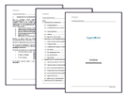
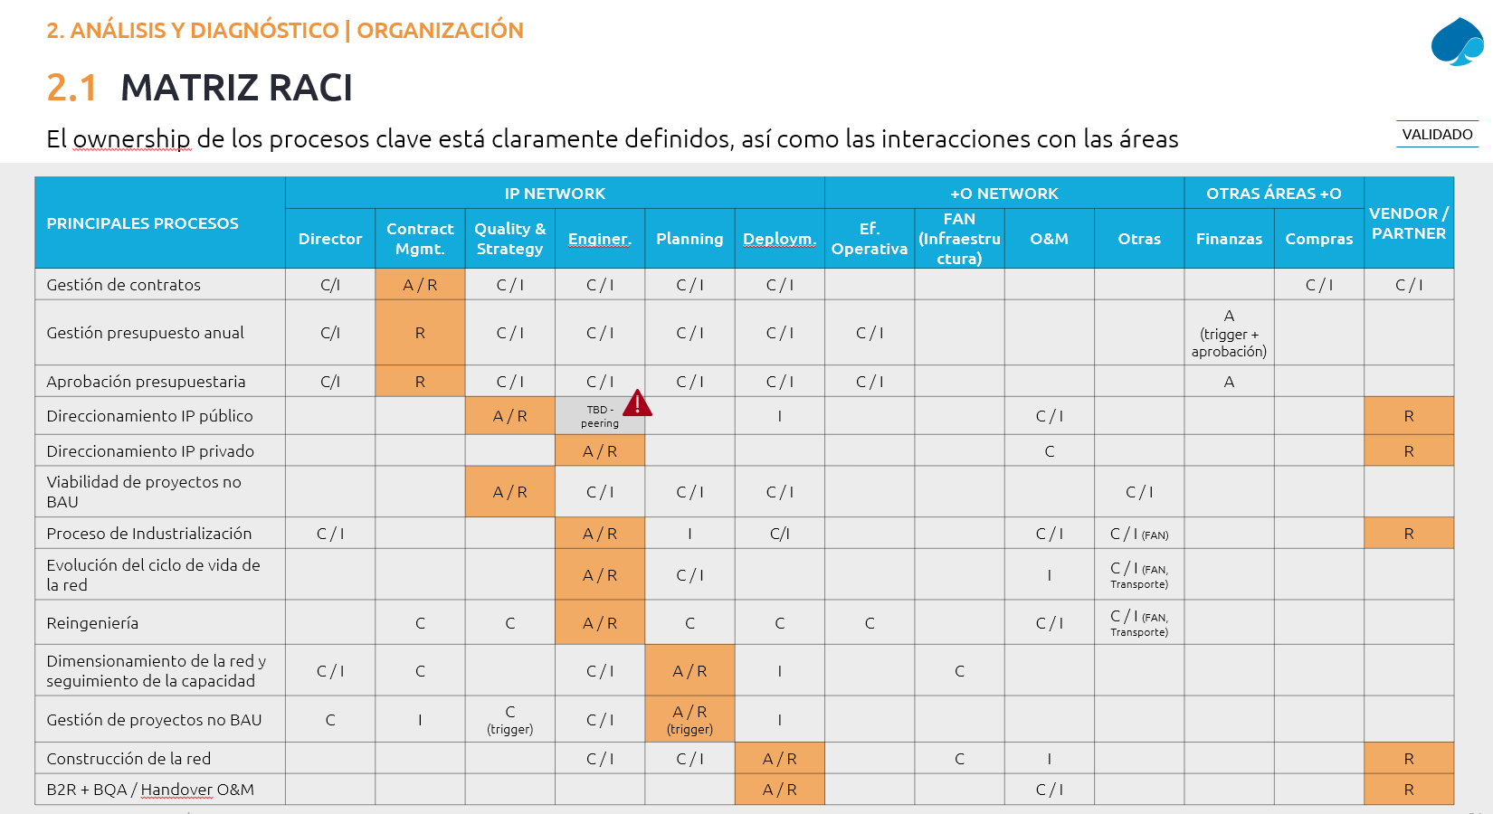
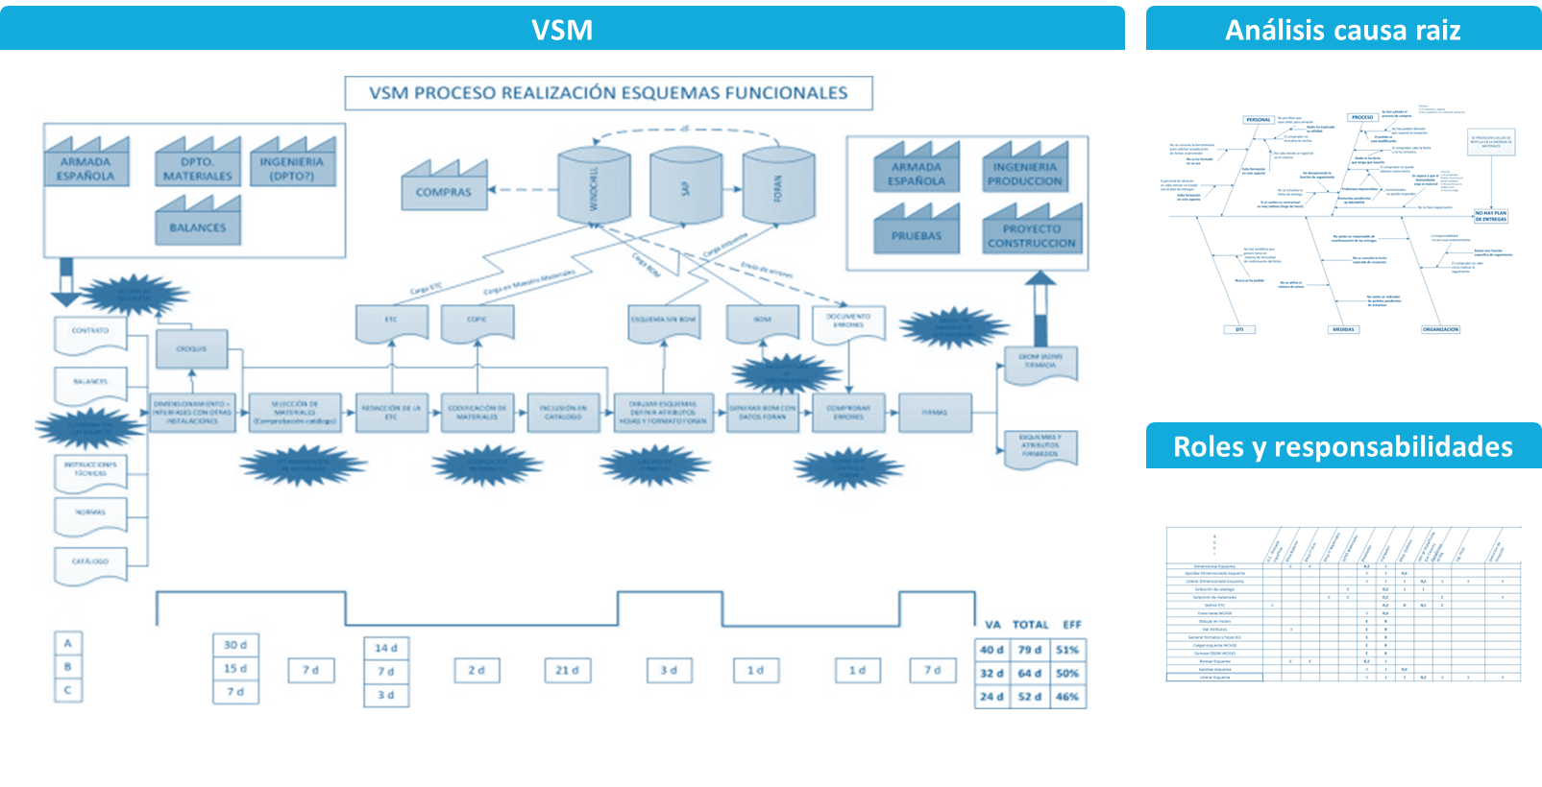
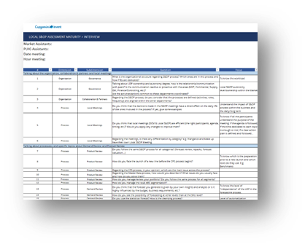
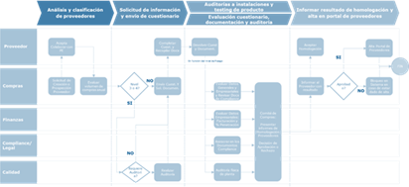
1. MOBILIZATION AND PREPARATION
1
MOBILIZATION AND PREPARATION
2
S&OP MATURITY ASSESSMENT
3
ASPIRATIONAL DEFINITION AND TARGET S&OP CYCLE
4
DEMAND AND SUPPLY PROCESSES DESIGN
4
IMPLEMENTATION READINESS AND CHANGE MANAGEMENT
6
DEPLOYMENT
Illustrative
INPUTS/DOCUMENTATION TO BE REQUESTED:
Organization charts (supply chain, planning, finance, marketing…)
Key stakeholder list
Existing S&OP documentation
Planning calendars
Kick off of the project
Organization and process analysis
KEY ACTIVITIES:
Project set up and governance
  Confirm scope, objectives and success criteria
  Define governance, escalation model and reporting forums
Stakeholder alignment
  Identify key stakeholders across demand, supply, finance, IT, marketing…
  Align on roles and engagement model
  Segmentation framing
  Identify relevant segmentation axis (i.e.: store typologies, categories, channels, flows…)
  Agree on representative planning segments to be used through the assessment and design phases
Planning system context (RELEX)
  Understand deployment timeline
  Identify key constraints and design principles linked to the system
Execution planning
  Define detailed workplan, milestones and workshops/interviews roadmap
Kick-off meeting
Defined planning segments
Plan for incoming weeks

Slide 21
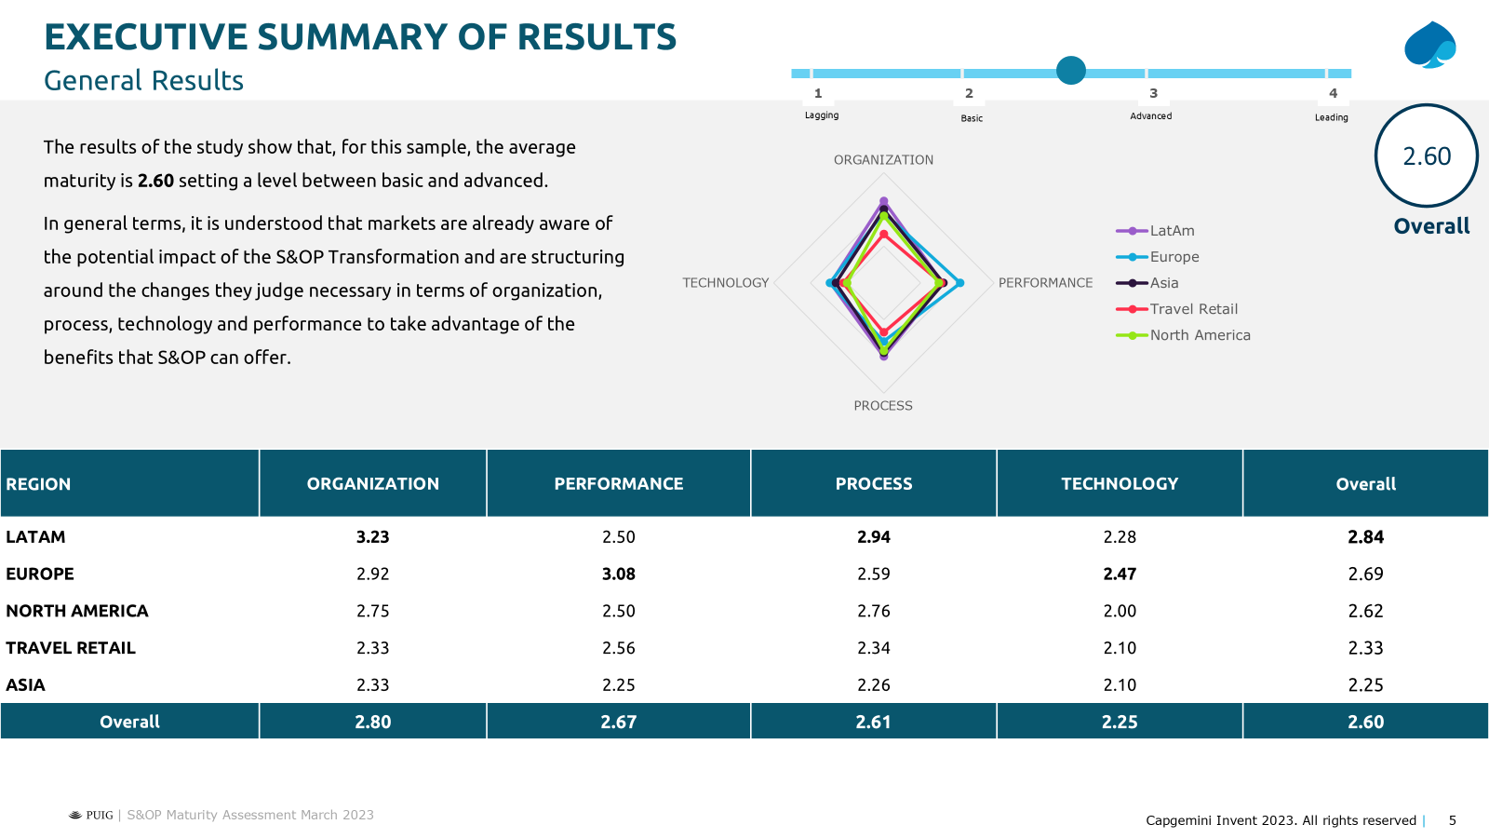
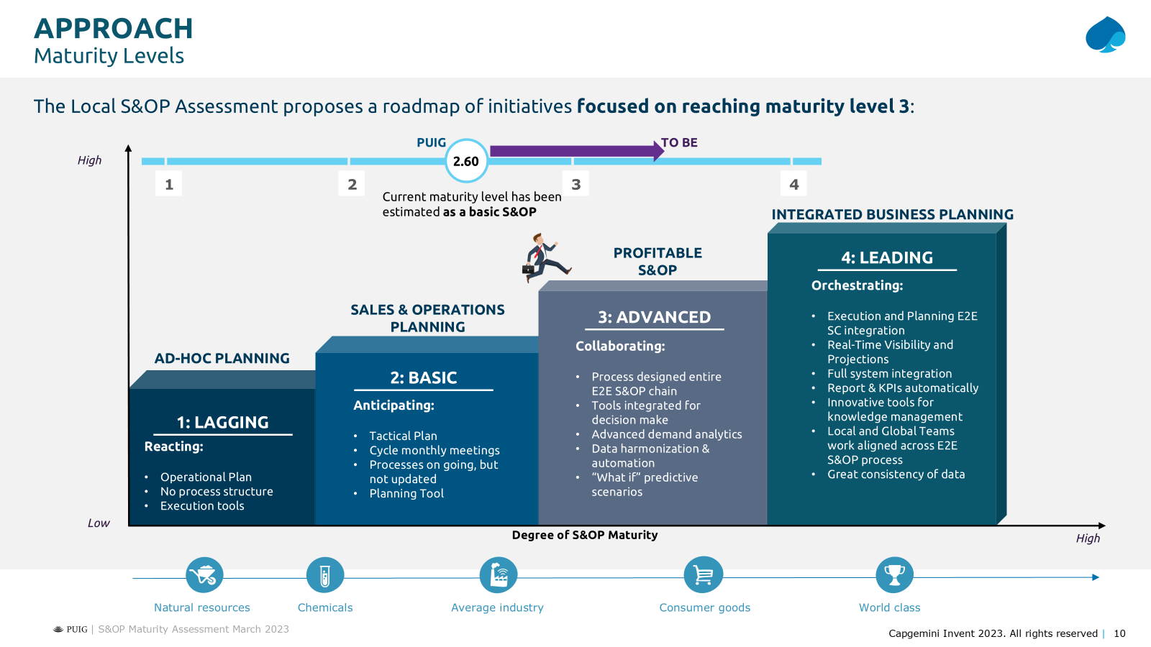
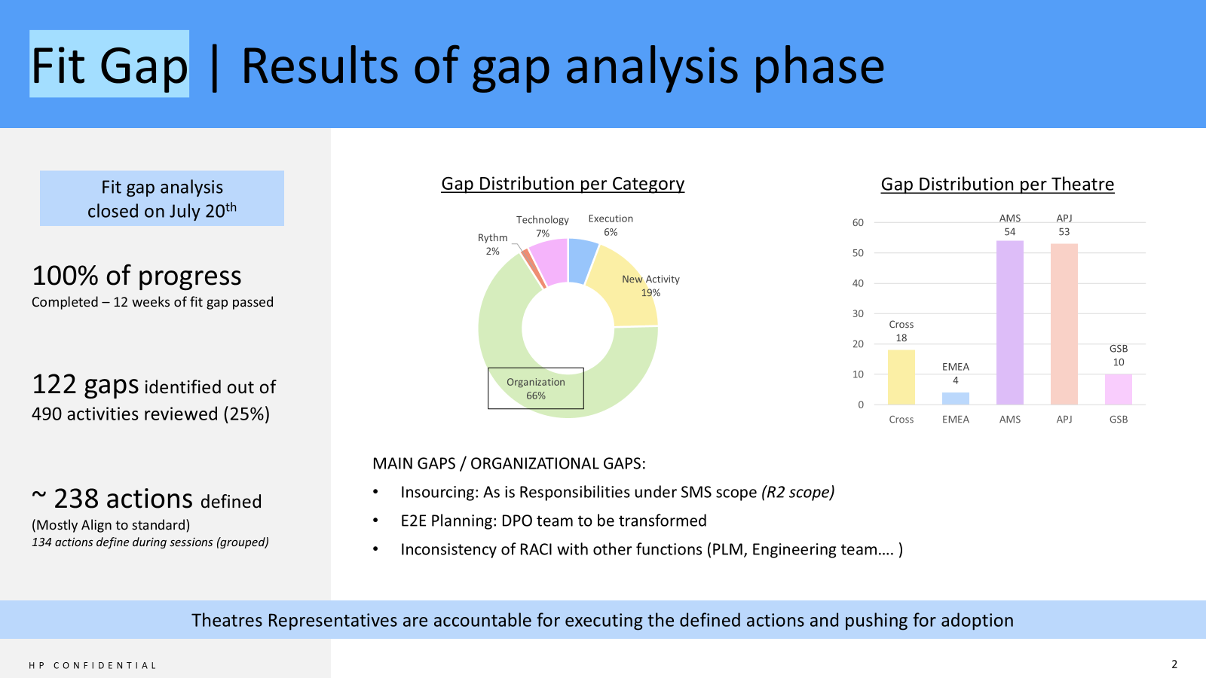
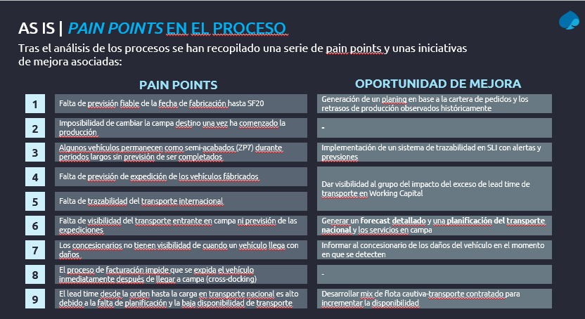
2. MATURITY ASSESSMENT and
aspirational definition
1
MOBILIZATION AND PREPARATION
2
S&OP MATURITY ASSESSMENT
3
ASPIRATIONAL DEFINITION AND TARGET S&OP CYCLE
4
DEMAND AND SUPPLY PROCESSES DESIGN
5
IMPLEMENTATION READINESS AND CHANGE MANAGEMENT
6
DEPLOYMENT
Illustrative
Current-state S&OP and Planning assessment
  Review existing processes documentation, planning policies…
  Analyse historical KPIs and performance data (forecast accuracy, inventory, service levels…)
  Conduct interviews with the key stakeholders
  Map roles and responsibilities within the processes
  Map current decision-making forums, participants, cadence…
  Identify pain points, bottlenecks, inconsistencies…
  Maturity evaluation across segments and key dimensions: processes and governance, organization, data, KPIs and reporting and usage of systems/technology
  Define aspirational principles
  Conduct workshops to agree on decision rights, governance model, integration with business strategy…
  Define target decision-making cadence, escalation paths and accountability
  Align on data and technology principles (i.e.: KPI standardization)
  Fit-gap analysis and position current vs. aspirational maturity
  Compare current state against aspirational principles
  Document gaps, risks and improvement opportunities by segment
Maturity assessment results by segment
Defined aspirational principles and ambition level
Fit-gap analysis by segment
Key insights and implications summary

Slide 22
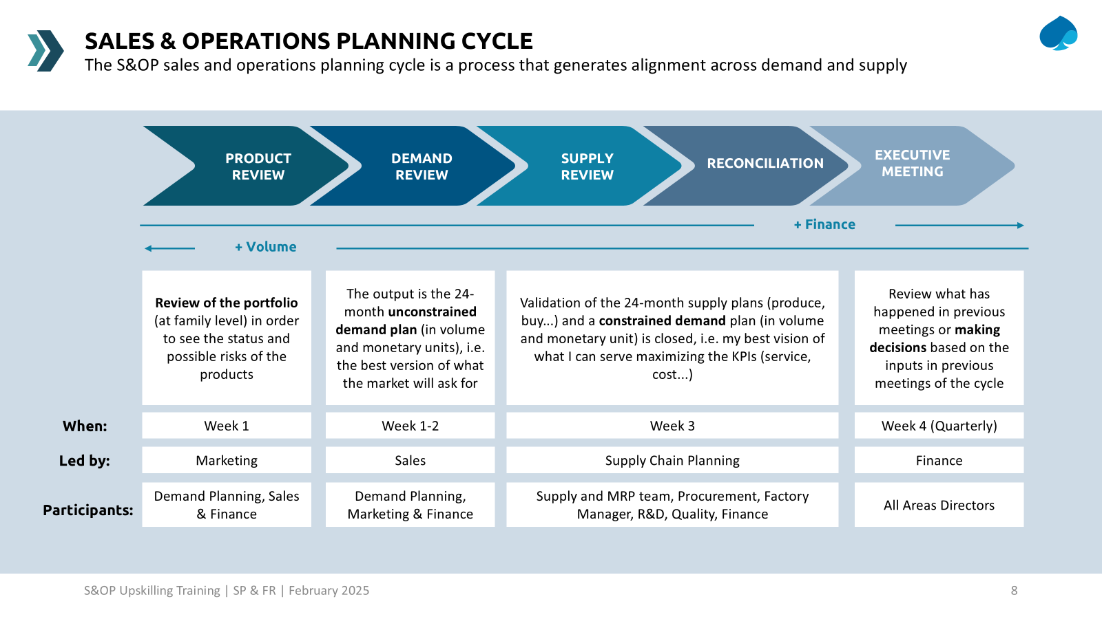
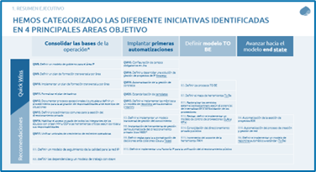
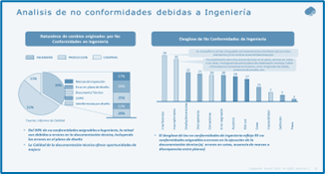
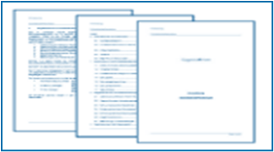
3. TARGET S&OP CYCLE definition
1
MOBILIZATION AND PREPARATION
2
S&OP MATURITY ASSESSMENT
3
ASPIRATIONAL DEFINITION AND TARGET S&OP CYCLE
4
DEMAND AND SUPPLY PROCESSES DESIGN
5
IMPLEMENTATION READINESS AND CHANGE MANAGEMENT
6
DEPLOYMENT
Illustrative
Define cycle structure
  Map the end-to-end S&OP cycle including inputs, outputs and decision points, specifying how to integrate inputs from different planning segments
  Define cadence of planning forums
  Decision rights and governance
  Identify forum participants, owners of decisions and escalation paths
  Define responsibilities for key decisions (i.e.: capacity, demand consensus, inventory policies…)
  Data & reporting principles
  Define standard S&OP views, aggregation levels and planning horizons
  Define minimum data standards required for effective S&OP and enable comparable decision-making across different segments
  Demand and supply planning requirements to support S&OP decisions
  Validation and alignment
  Validate S&OP cycle feasibility with RELEX
  Validate with key stakeholders the S&OP cycle defined
  Documentation of new S&OP cycle
  Develop standard operating procedures (SOPs), manuals and documentation needed to support execution
Target S&OP cycle and governance
Clear requirements for demand and supply planning
S&OP data and reporting principles
Validated alignment with RELEX functionalities

Slide 23
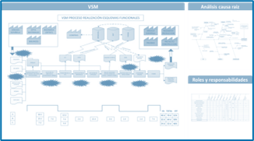
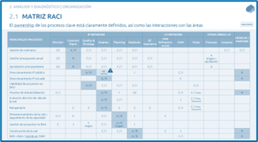
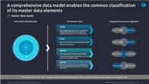
4. DEMAND AND SUPPLY ORGANIZATION AND
PROCESS DESIGN
1
MOBILIZATION AND PREPARATION
2
S&OP MATURITY ASSESSMENT
3
ASPIRATIONAL DEFINITION AND TARGET S&OP CYCLE
4
DEMAND AND SUPPLY PROCESSES DESIGN
5
IMPLEMENTATION READINESS AND CHANGE MANAGEMENT
6
DEPLOYMENT
Illustrative
Demand planning process design
  Define process flow, inputs, outputs and planning horizons
  Define differentiated rules by store typology, category or channel
  Define interfaces with S&OP cycle
  Supply planning process design
  Define process flow, inputs and outputs
  Explicit definition of supply constraints and feasibility rules
  Structured scenario creation and comparison
  Clear escalation and trade-offs into S&OP decision forums across segments
  Organizational design
  Define roles, responsibilities and interaction model
  Define FTE sizing principles and workload drivers
  Data & master data
  Define master data and planning parameters requirements
  Identify data ownership and quality requirements by planning segment
  System enablement
  Validate planning processes feasibility with RELEX
  Validate with key stakeholders the planning processes and organization
  Documentation of new planning processes
  Develop standard operating procedures (SOPs), manuals and documentation needed to support execution
Target demand and supply planning processes
Target organization model and FTE sizing principles
Data and master data requirements
Validated process-organization-RELEX fit

Slide 24
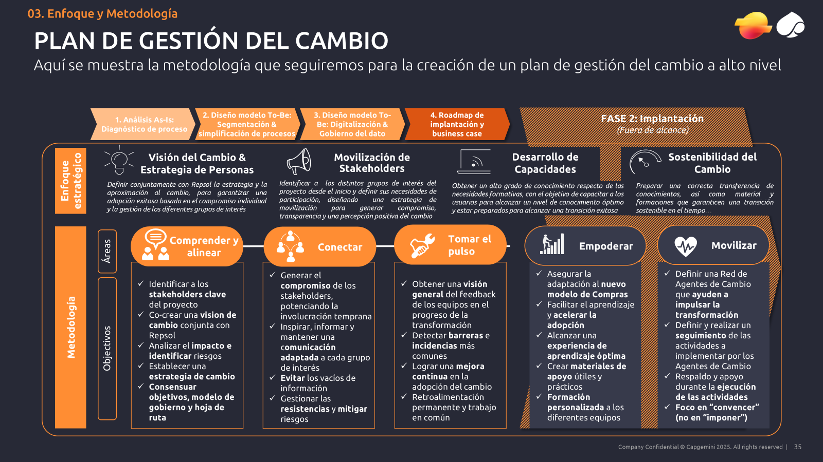
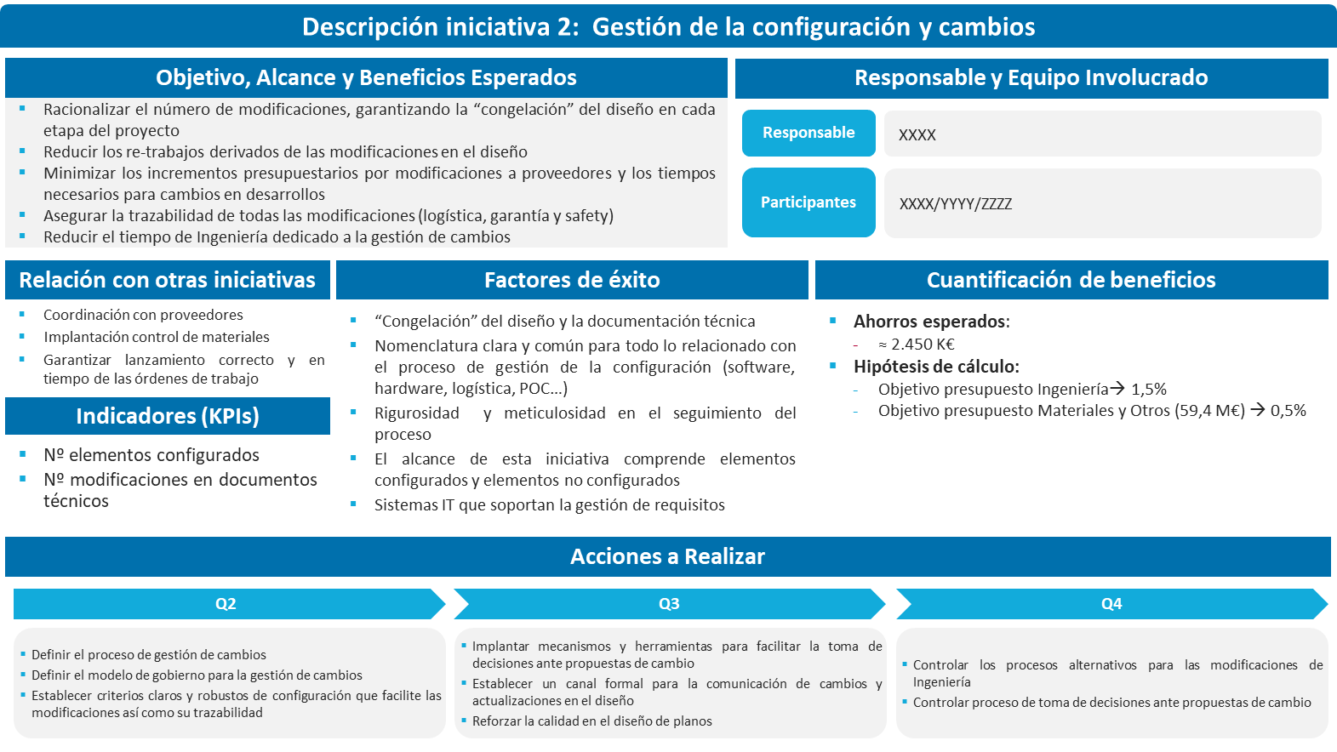

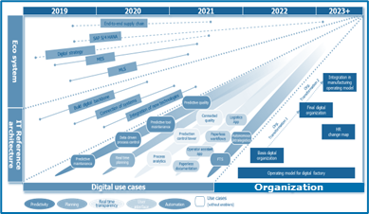
5. IMPLEMENTATION READINESS, CHANGE
MANAGEMENT & KPIs
1
MOBILIZATION AND PREPARATION
2
S&OP MATURITY ASSESSMENT
3
ASPIRATIONAL DEFINITION AND TARGET S&OP CYCLE
4
DEMAND AND SUPPLY PROCESSES DESIGN
5
IMPLEMENTATION READINESS AND CHANGE MANAGEMENT
6
DEPLOYMENT
Illustrative
Initiative definition
  Translate target model into concrete implementation activities
  Cluster initiatives into workstreams (process, organization…)
  Identify segment-specific vs. cross-segment initiatives
  Prioritization and waves
  Prioritize initiatives based on impact, complexity and dependencies
  Define deployment waves and sequency by store cluster, category or flow
  Change impact and adoption plan
  Assess change impact by role and function and segment
  Identify adoption risks and mitigation actions
  Communication and capability enablement
  Define communication strategy and key messages
  Define role-based and segment-adapted training approach
  KPIs and performance management
  Define adoption and performance KPIs
  Roadmap and deployment readiness and go/no go criteria definition
  Define a consolidated roadmap
  Define deployment readiness criteria to validate (process readiness, org. readiness, data readiness, system readiness…)
  Define go/no go decision process and ownership
  Define remediation actions in case criteria are not met
Initiatives backlog and sheets by initiative
Change management and training plans
KPIs and performance management framework
Integrated implementation roadmap

